Slide 1
21CSS201T COMPUTER ORGANIZATION AND ARCHITECTURE UNIT-5

Slide 2
Contents
Parallelism: Need, types , applications and challenges
Architecture of Parallel Systems-Flynn’s classification
ARM Processor: The thumb instruction set
Processor and CPU cores, Instruction Encoding format
Memory load and Store instruction
Basics of I/O operations.
Case study: ARM 5 and ARM 7 Architecture

Slide 3
Parallelism
Executing two or more operations at the same time is known as parallelism.
Parallel processing is a method to improve computer system performance by executing two or more instructions simultaneously
A parallel computer is a set of processors that are able to work cooperatively to solve a computational problem.
Two or more ALUs in CPU can work concurrently to increase throughput
The system may have two or more processors operating concurrently

Slide 4
Goals of parallelism
To increase the computational speed (ie) to reduce the amount of time that you need to wait for a problem to be solved
To increase throughput (ie) the amount of processing that can be accomplished during a given interval of time
To improve the performance of the computer for a given clock speed
To solve bigger problems that might not fit in the limited memory of a single CPU

Slide 5
Applications of Parallelism
Numeric weather prediction
Socio economics
Finite element analysis
Artificial intelligence and automation
Genetic engineering
Weapon research and defence
Medical Applications
Remote sensing applications

Slide 6
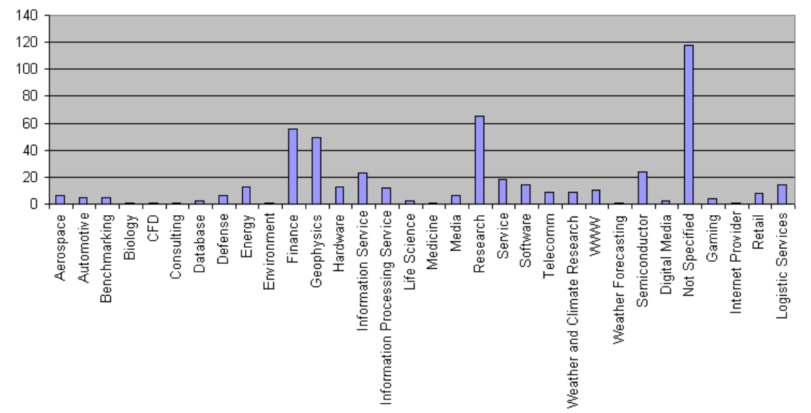
Applications of Parallelism

Slide 7
Types of parallelism
1. Hardware Parallelism
2. Software Parallelism
Hardware Parallelism :
The main objective of hardware parallelism is to increase the processing speed. Based on the hardware architecture, we can divide hardware parallelism into two types: Processor parallelism and memory parallelism.
Processor parallelism
Processor parallelism means that the computer architecture has multiple nodes, multiple CPUs or multiple sockets, multiple cores, and multiple threads.
Memory parallelism means shared memory, distributed memory, hybrid distributed shared memory, multilevel pipelines, etc. Sometimes, it is also called a parallel random access machine (PRAM). “It is an abstract model for parallel computation which assumes that all the processors operate synchronously under a single clock and are able to randomly access a large shared memory. In particular, a processor can execute an arithmetic, logic, or memory access operation within a single clock cycle”. This is what we call using overlapping or pipelining instructions to achieve parallelism.

Slide 8
Hardware Parallelism
One way to characterize the parallelism in a processor is by the number of instruction issues per machine cycle.
If a processor issues k instructions per machine cycle, then it is called a k-issue processor.
In a modern processor, two or more instructions can be issued per machine cycle.
A conventional processor takes one or more machine cycles to issue a single instruction. These types of processors are called one-issue machines, with a single instruction pipeline in the processor.
A multiprocessor system which built n k-issue processors should be able to handle a maximum of nk threads of instructions simultaneously

Slide 9
Software Parallelism
It is defined by the control and data dependence of programs.
The degree of parallelism is revealed in the program flow graph.
Software parallelism is a function of algorithm, programming style, and compiler optimization.
The program flow graph displays the patterns of simultaneously executable operations.
Parallelism in a program varies during the execution period .
It limits the sustained performance of the processor.

Slide 10
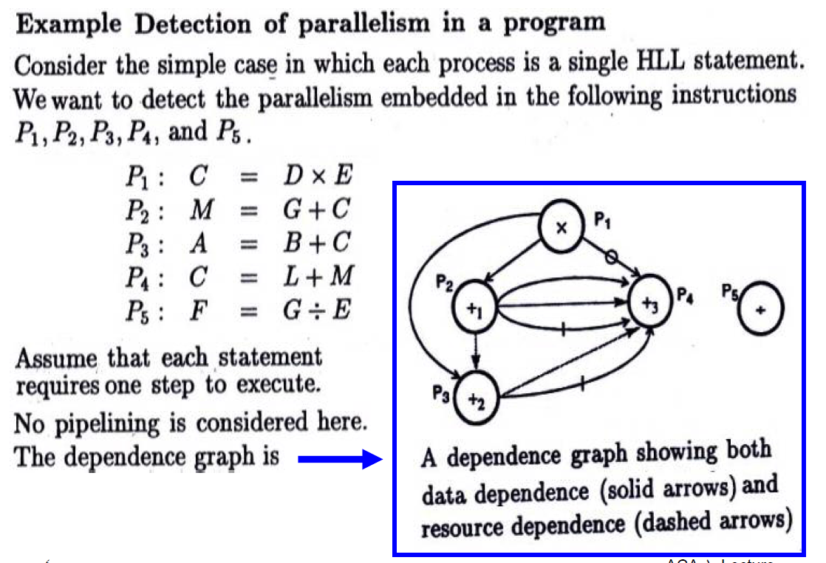

Slide 11
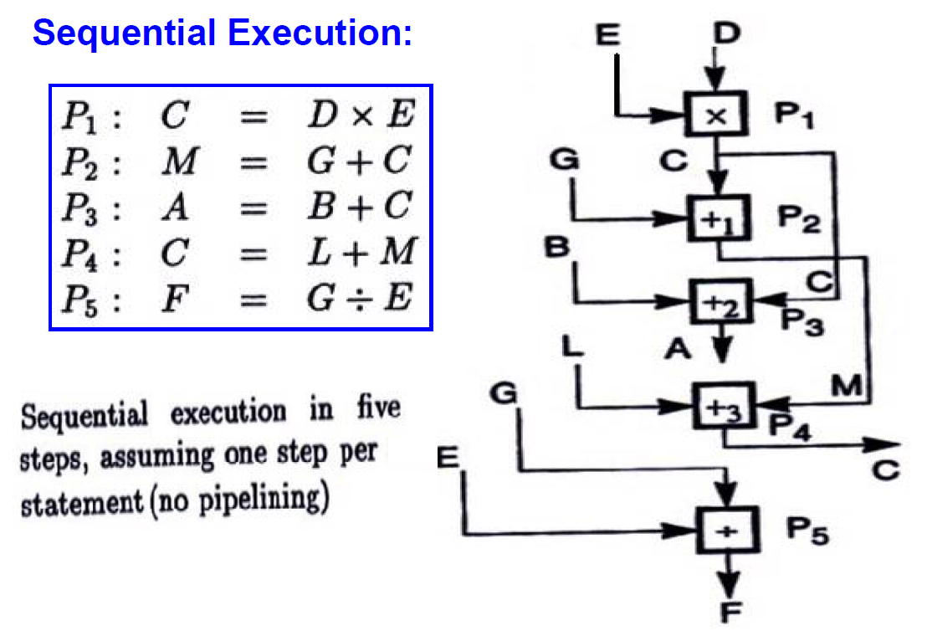

Slide 12
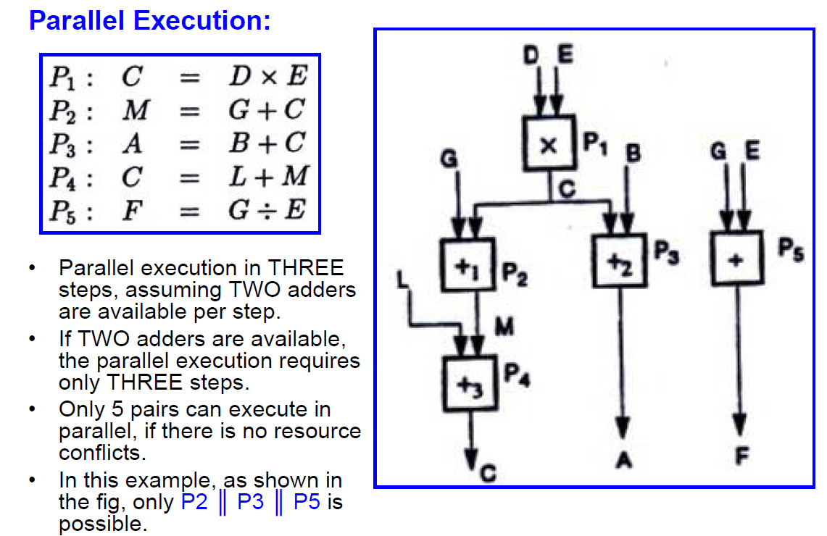

Slide 13
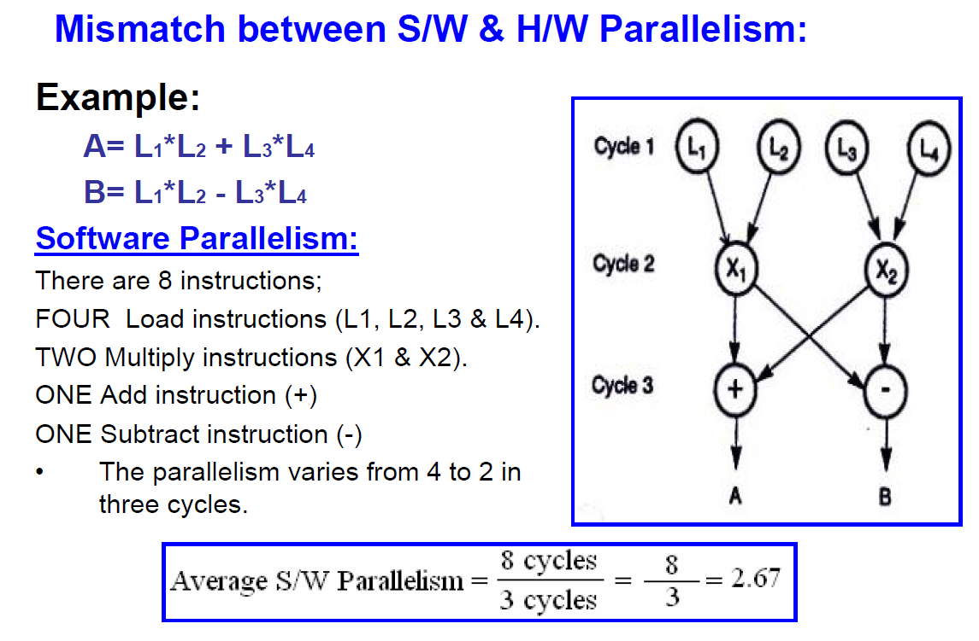

Slide 14
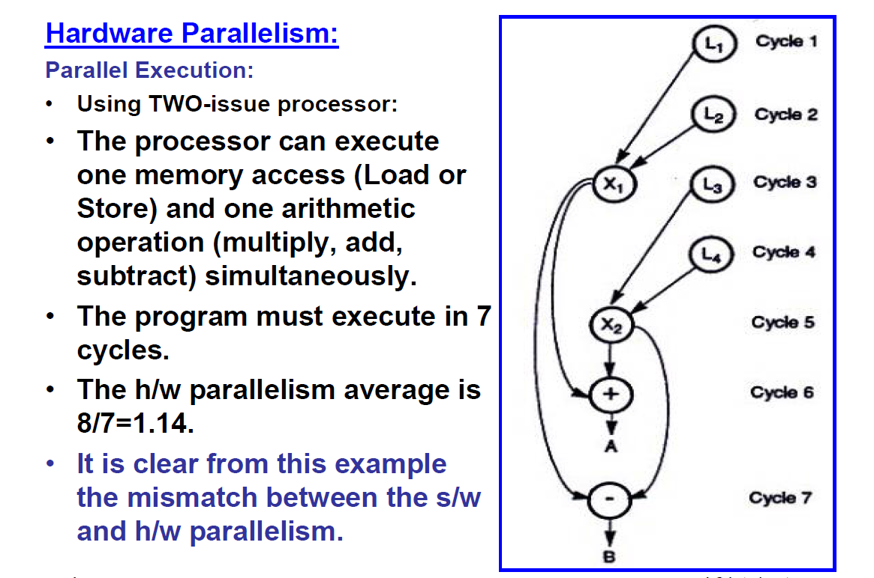

Slide 15
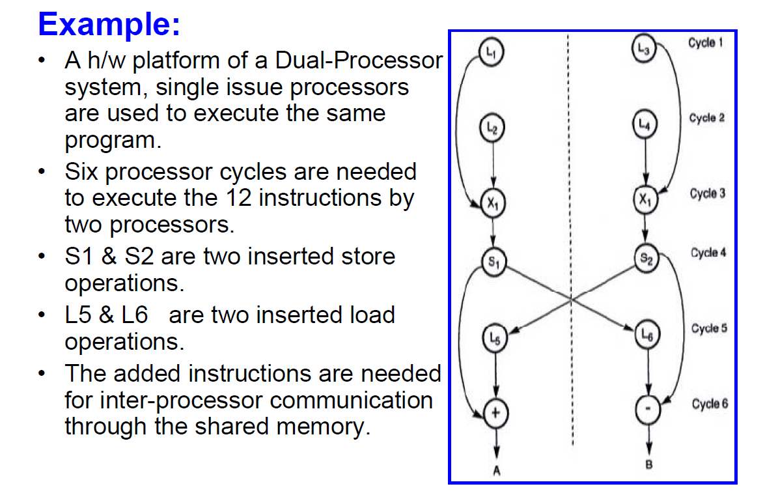

Slide 16
Software Parallelism - types
Parallelism in Software
Instruction level parallelism
Task-level parallelism
Data parallelism
Transaction level parallelism

Slide 17
Instruction level parallelism
Instruction level Parallelism (ILP) is a measure of how many operations can be performed in parallel at the same time in a computer.
Parallel instructions are set of instructions that do not depend on each other to be executed.
ILP allows the compiler and processor to overlap the execution of multiple instructions or even to change the order in which instructions are executed.

Slide 18
Eg. Instruction level parallelism
Consider the following example
1. x= a+b
2. y=c-d
3. z=x * y
Operation 3 depends on the results of 1 & 2
So ‘Z ‘ cannot be calculated until X & Y are calculated
But 1 & 2 do not depend on any other. So they can be computed simultaneously.

Slide 19
If we assume that each operation can be completed in one unit of time then these 3 operations can be completed in 2 units of time .
ILP factor is 3/2=1.5 which is greater than without ILP.
A superscalar CPU architecture implements ILP inside a single processor which allows faster CPU throughput at the same clock rate.

Slide 20
Data-level parallelism (DLP)
Data parallelism is parallelization across multiple processors in parallel computing environments.
It focuses on distributing the data across different nodes, which operate on the data in parallel.
Instructions from a single stream operate concurrently on several data

Slide 21
DLP - example
Let us assume we want to sum all the elements of the given array of size n and the time for a single addition operation is Ta time units.
In the case of sequential execution, the time taken by the process will be n*Ta time unit
if we execute this job as a data parallel job on 4 processors the time taken would reduce to (n/4)*Ta + merging overhead time units.

Slide 22
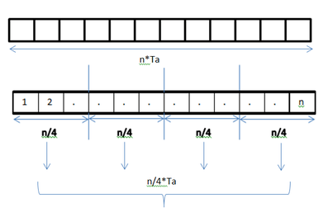
DLP in Adding elements of array

Slide 23
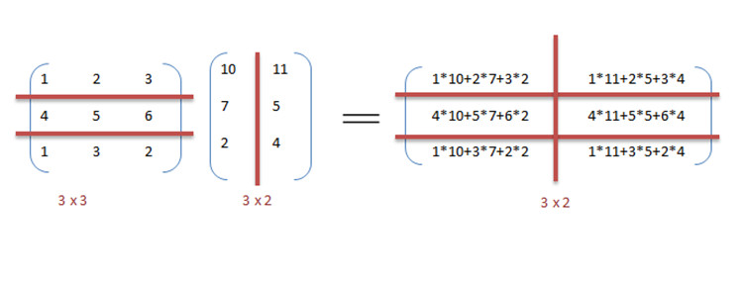
DLP in matrix multiplication
A[m x n] dot B [n x k] can be finished in O(n) instead of O(m∗n∗k ) when executed in parallel using m*k processors.

Slide 24
The locality of data references plays an important part in evaluating the performance of a data parallel programming model.
Locality of data depends on the memory accesses performed by the program as well as the size of the cache.

Slide 25
Flynn’s Classification
Was proposed by researcher Michael J. Flynn in 1966.
It is the most commonly accepted taxonomy of computer organization.
In this classification, computers are classified by whether it processes a single instruction at a time or multiple instructions simultaneously, and whether it operates on one or multiple data sets.

Slide 26
Flynn’s Classification
This taxonomy distinguishes multi-processor computer architectures according to the two independent dimensions of Instruction stream and Data stream.
An instruction stream is sequence of instructions executed by machine.
A data stream is a sequence of data including input, partial or temporary results used by instruction stream.
Each of these dimensions can have only one of two possible states: Single or Multiple.
Flynn’s classification depends on the distinction between the performance of control unit and the data processing unit rather than its operational and structural interconnections.

Slide 27
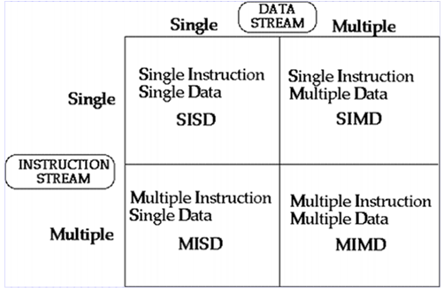
Flynn’s Classification
Four category of Flynn classification

Slide 28
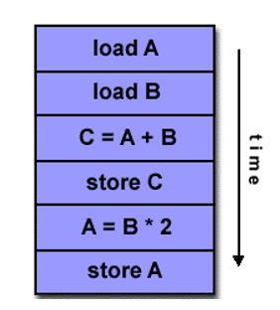
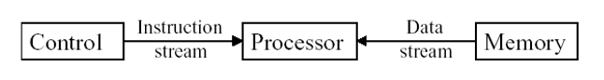
SISD
They are also called scalar processor i.e., one instruction at a time and each instruction have only one set of operands.
Single instruction: only one instruction stream is being acted on by the CPU during any one clock cycle.
Single data: only one data stream is being used as input during any one clock cycle.
Deterministic execution.
Instructions are executed sequentially.
SISD computer having one control unit, one processor unit and single memory unit.

Slide 29
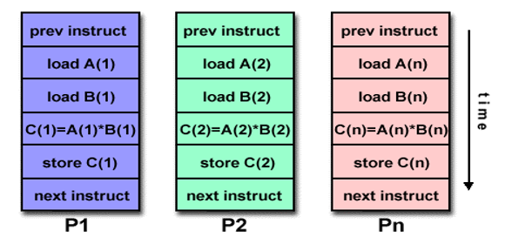
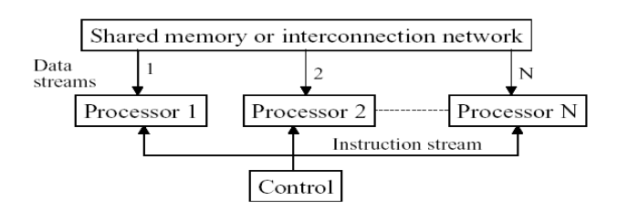
SIMD
A type of parallel computer.
Single instruction: All processing units execute the same instruction issued by the control unit at any given clock cycle .
Multiple data: Each processing unit can operate on a different data element as shown if figure below the processor are connected to shared memory or interconnection network providing multiple data to processing unit
single instruction is executed by different processing unit on different set of data

Slide 30
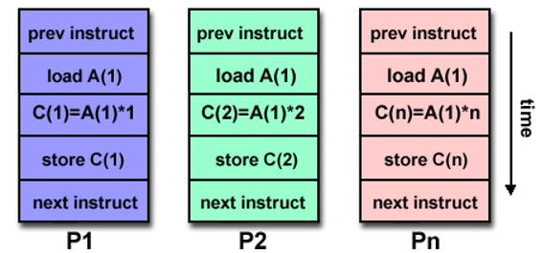
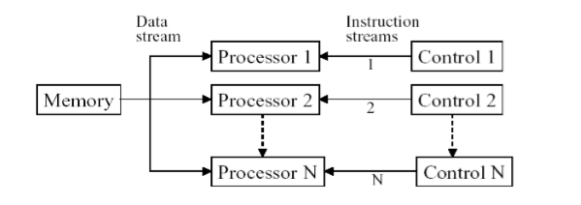
MISD
A single data stream is fed into multiple processing units.
Each processing unit operates on the data independently via independent instruction.
A single data stream is forwarded to different processing unit which are connected to different control unit and execute instruction given to it by control unit to which it is attached.
same data flow through a linear array of processors executing different instruction streams

Slide 31
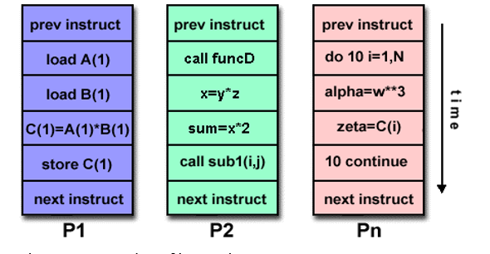
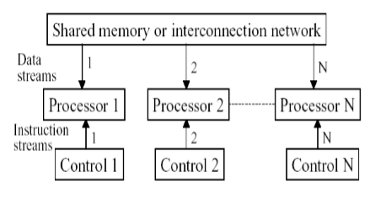
MIMD
Multiple Instruction: every processor may be executing a different instruction stream.
Multiple Data: every processor may be working with a different data stream.
Execution can be synchronous or asynchronous, deterministic or nondeterministic
Different processor each processing different task.

Slide 32
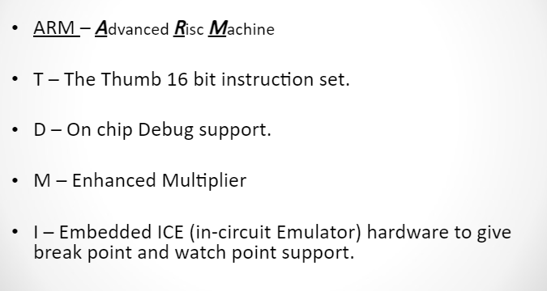

Slide 33
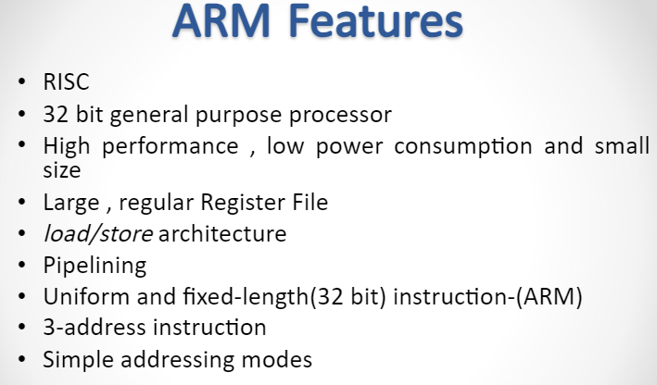

Slide 34
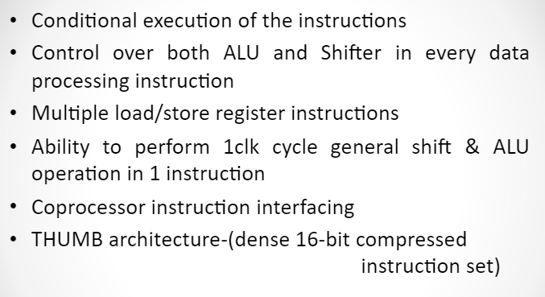
ARM Features Contd…

Slide 35
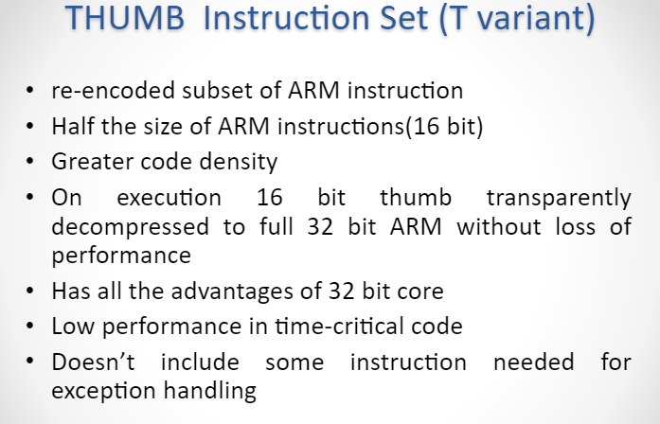

Slide 36
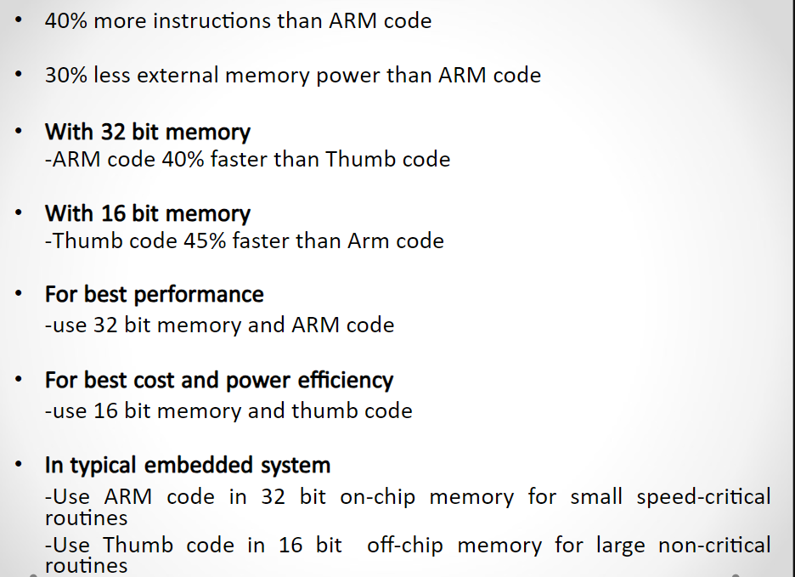
Thumb instruction set (T variant) Contd….

Slide 37
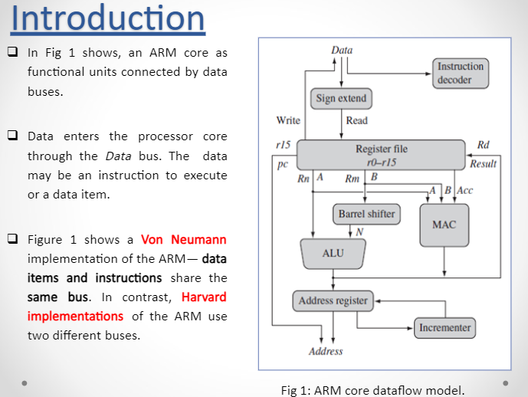
ARM Core dataflow model

Slide 38
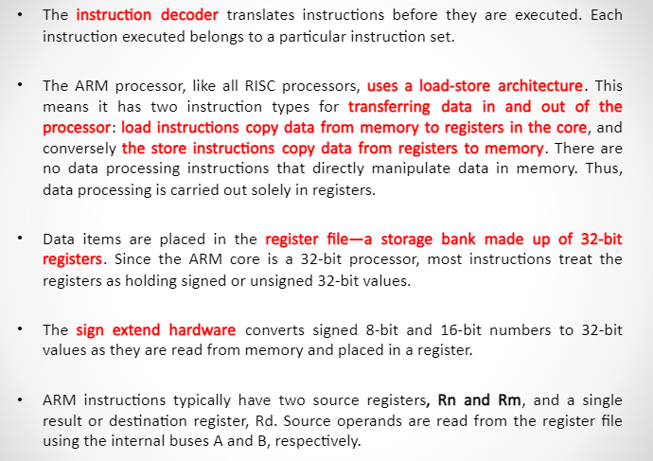

Slide 39
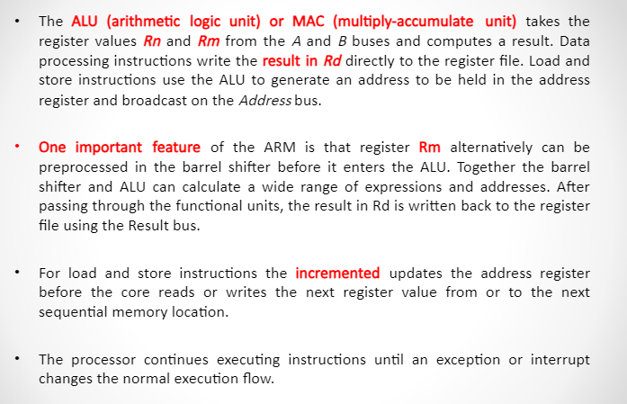

Slide 40
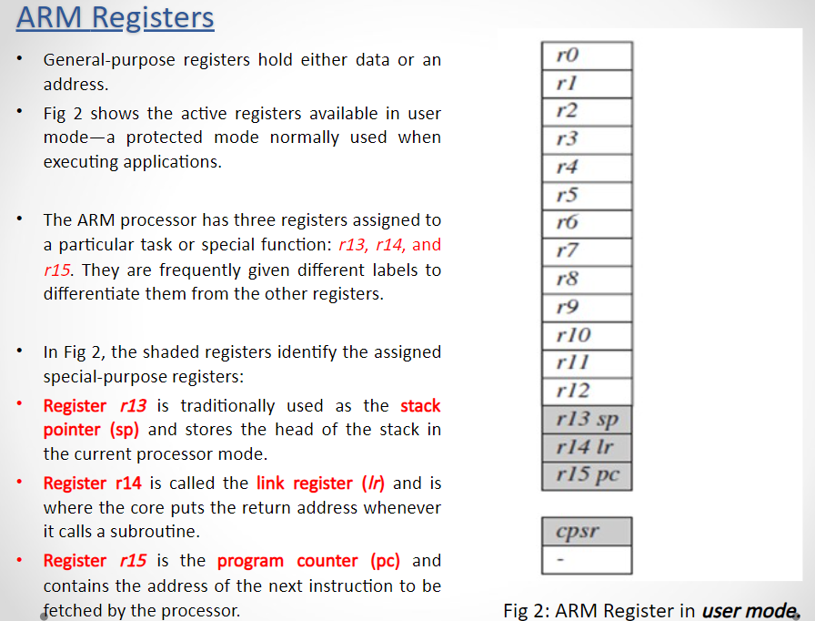

Slide 41
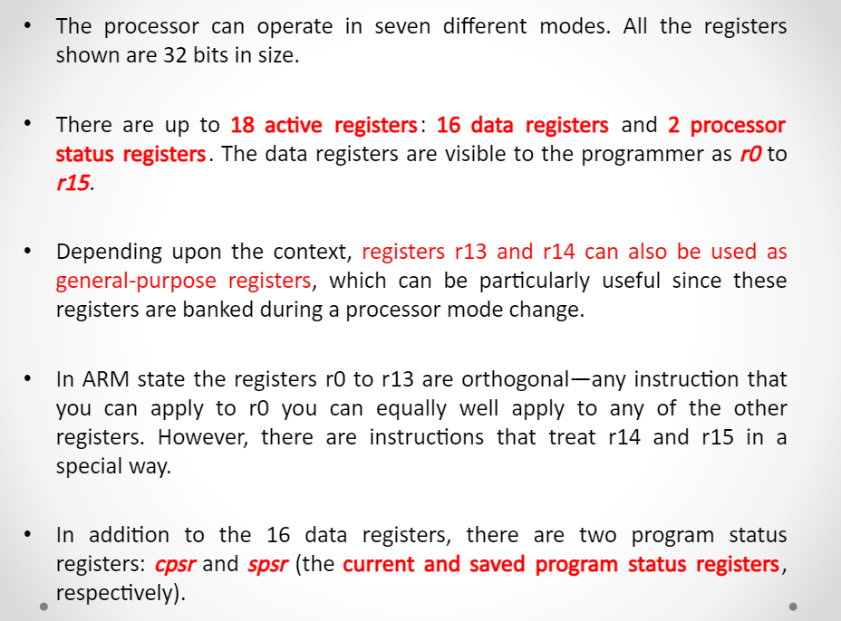

Slide 42
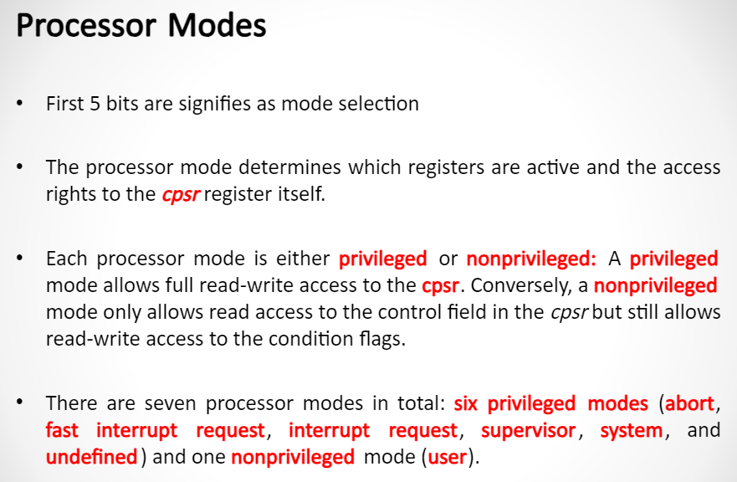

Slide 43
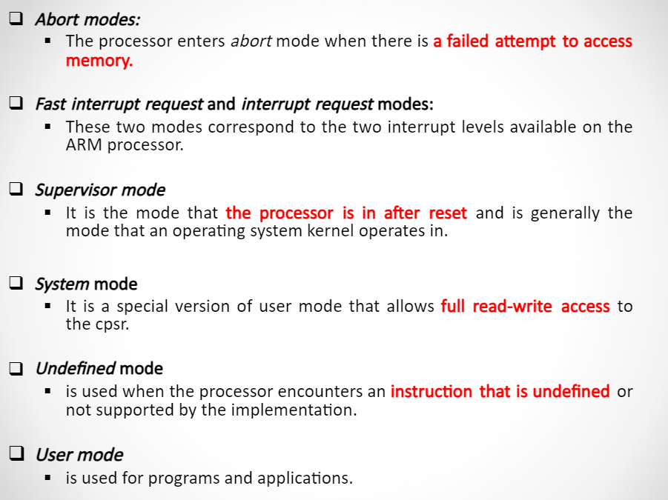

Slide 44
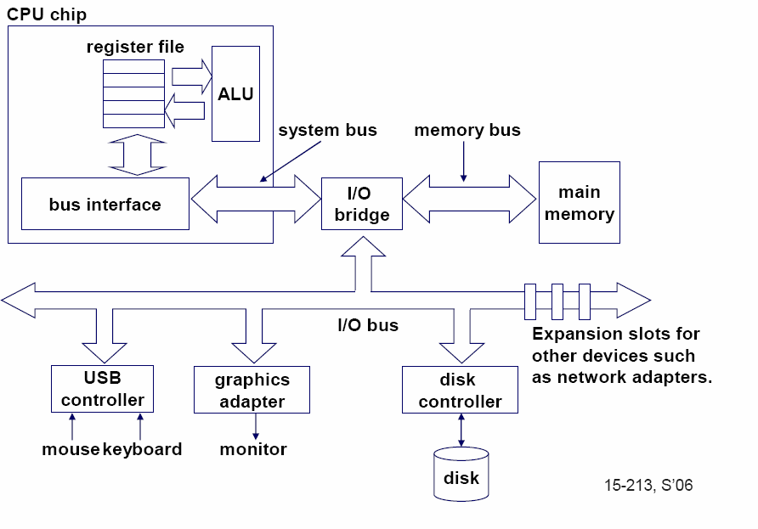
Single-core computer

Slide 45
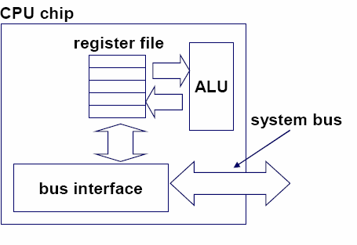
Single-core CPU chip
the single core

Slide 46
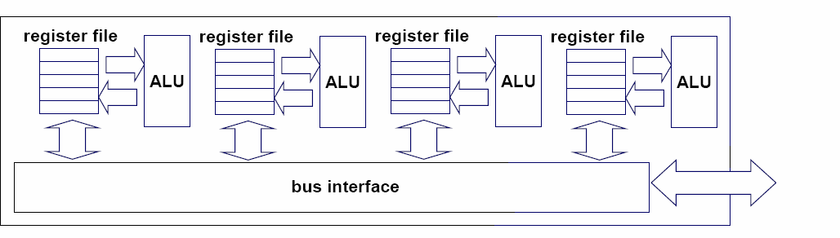
Multi-core architectures
Replicate multiple processor cores on a single die.
Core 1 Core 2 Core 3 Core 4
Multi-core CPU chip

Slide 47
Multi-core CPU chip
The cores fit on a single processor socket
Also called CMP (Chip Multi-Processor)
c o r e 1 | c o r e 2 | c o r e 3 | c o r e 4

Slide 48
The cores run in parallel
thread 1 thread 2 thread 3 thread 4
c
c
c
c
o
o
o
o
r e
r e
r e
r e
1
2
3
4

Slide 49
Within each core, threads are time-sliced (just like on a uniprocessor)
several threads
several threads
several threads
several threads
c
c
c
c
o
o
o
o
r e
r e
r e
r e
1
2
3
4

Slide 50
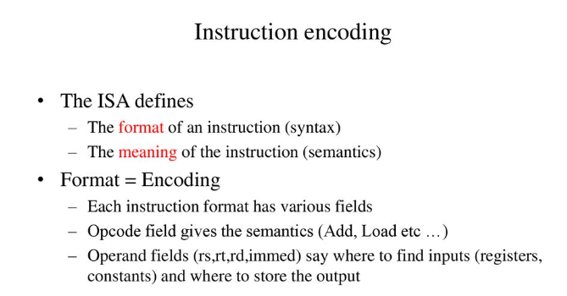

Slide 51
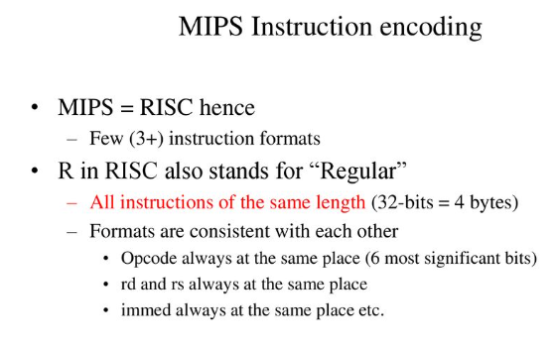

Slide 52
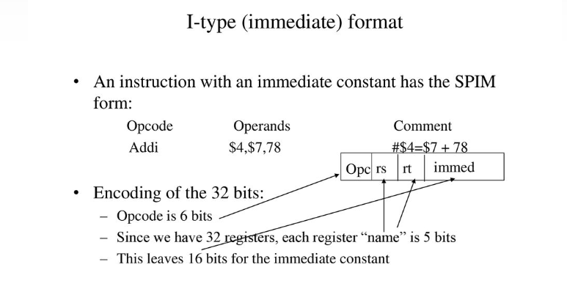

Slide 53
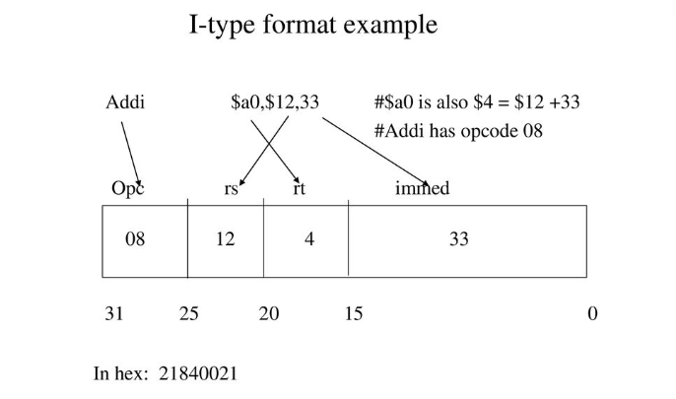

Slide 54
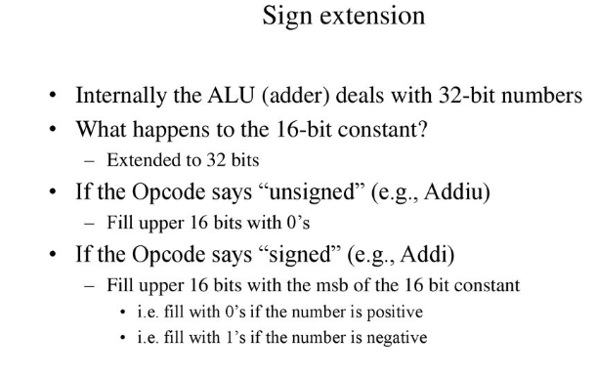

Slide 55
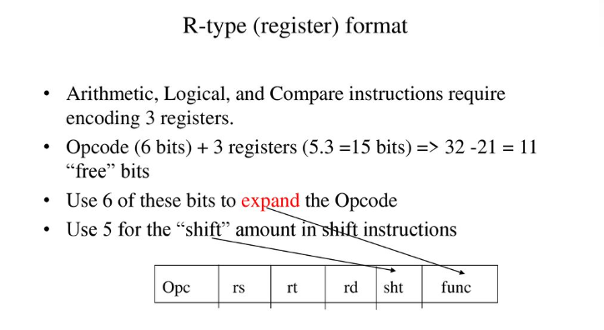

Slide 56
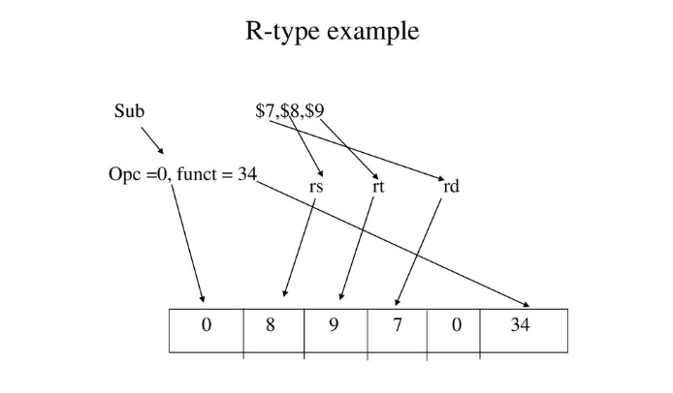

Slide 57
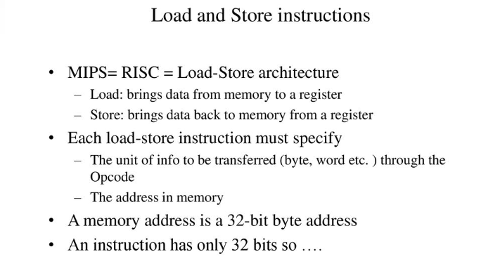

Slide 58
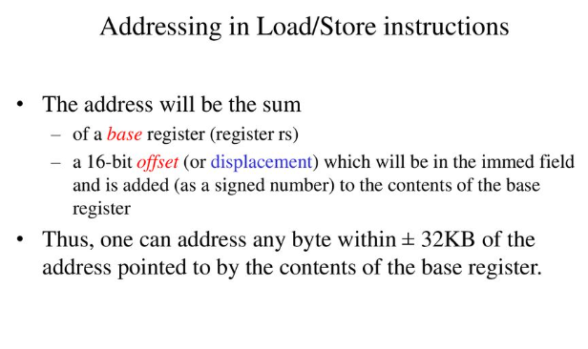

Slide 59
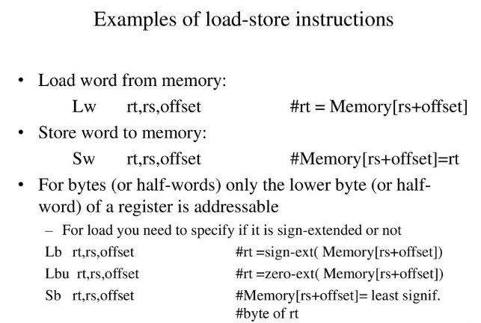

Slide 60
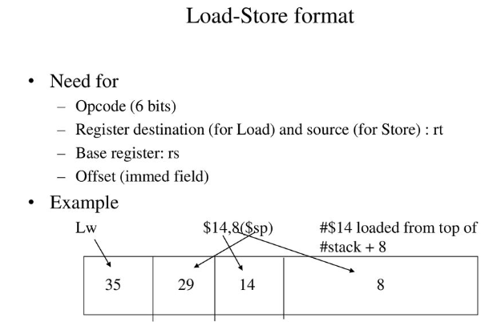

Slide 61
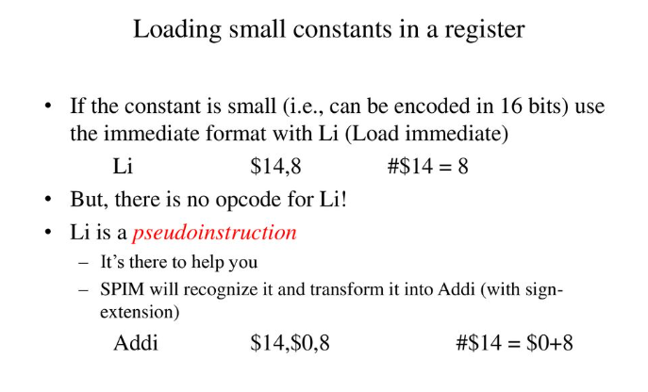

Slide 62
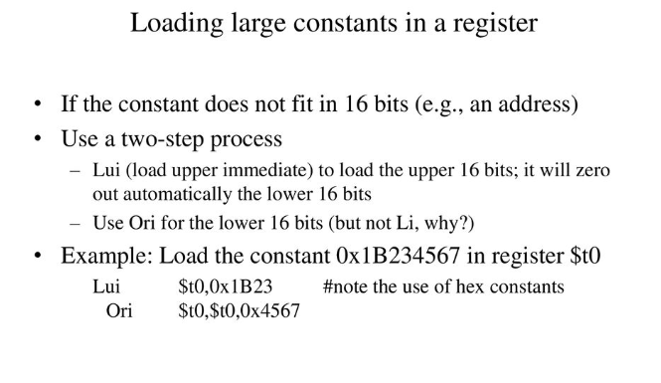

Slide 63
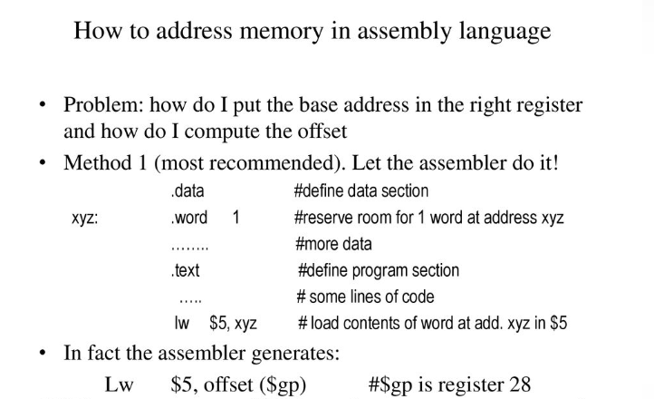

Slide 64
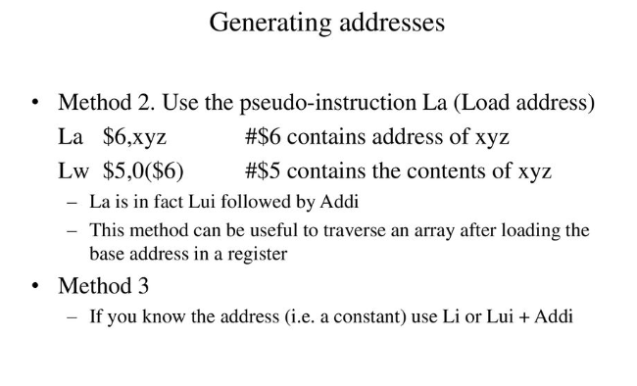

Slide 65
Difference between Memory mapped I/O and I/O mapped I/O
 | Memory Mapped Input/Output | Input/Output Mapped Input/Output
1. | Each port is treated as a memory location. | Each port is treated as an independent unit.
2. | CPU’s memory address space is divided between memory and input/output ports. | Separate address spaces for memory and input/output ports.
3. | Single instruction can transfer data between memory and port. | Two instruction are necessary to transfer data between memory and port.
4. | Data transfer is by means of instruction like MOVE. | Each port can be accessed by means of IN or OUT instructions.

Slide 66
Program Controlled I/O
Program controlled I/O is one in which the processor repeatedly checks a status flag to achieve the required synchronization between processor & I/O device.
The processor polls the device.
It is useful in small low speed systems where hardware cost must be minimized.
It requires that all input/output operators be executed under the direct control of the CPU.
The transfer is between CPU registers(accumulator) and a buffer register connected to the input/output device.
The i/o device does not have direct access to main memory.
A data transfer from an input/output device to main memory requires the execution of several instructions by the CPU, including an input instruction to transfer a word from the input/output device to the CPU and a store instruction to transfer a word from CPU to main memory.
One or more additional instructions may be needed for address communication and data word counting.

Slide 67
Typical Program controlled instructions
Name | Mnemonic
Branch | BR
Jump | JMP
Skip | SKP
Call | CALL
Return | RET
Compare | CMP
Test(by ADDing) | TST

Slide 68
Case study: ARM 5 and ARM 7 Architecture

Slide 69
Data Sizes and Instruction Sets
The ARM is a 32-bit architecture.
When used in relation to the ARM:
Byte means 8 bits
Halfword means 16 bits (two bytes)
Word means 32 bits (four bytes)
Most ARM’s implement two instruction sets
32-bit ARM Instruction Set
16-bit Thumb Instruction Set
Jazelle cores can also execute Java bytecode

Slide 70
Processor Modes
The ARM has seven basic operating modes:
User : unprivileged mode under which most tasks run
FIQ : entered when a high priority (fast) interrupt is raised
IRQ : entered when a low priority (normal) interrupt is raised
Supervisor : entered on reset and when a Software Interrupt
instruction is executed
Abort : used to handle memory access violations
Undef : used to handle undefined instructions
System : privileged mode using the same registers as user mode

Slide 71
The ARM Register Set
Current Visible Registers
Abort Mode
r0
r1
r2
Banked out Registers
r3
r4
r5
User
FIQ
IRQ
SVC
Undef
r6
r7
r8
r8
r9
r9
r10
r10
r11
r11
r12
r12
r13 (sp)
r13 (sp)
r13 (sp)
r13 (sp)
r13 (sp)
r13 (sp)
r14 (lr)
r14 (lr)
r14 (lr)
r14 (lr)
r14 (lr)
r14 (lr)
r15 (pc)
cpsr
spsr
spsr
spsr
spsr
spsr

Slide 72
Register Organization Summary
r0
User mode r0-r7, r15, and cpsr
User mode r0-r12, r15, and cpsr
User mode r0-r12, r15, and cpsr
User mode r0-r12, r15, and cpsr
User mode r0-r12, r15, and cpsr
r1
r2
r3
r4
Thumb state
Low registers
r5
r6
r7
r8
r8
r9
r9
Thumb state
High registers
r10
r10
r11
r11
r12
r12
r13 (sp)
r13 (sp)
r13 (sp)
r13 (sp)
r13 (sp)
r13 (sp)
r14 (lr)
r14 (lr)
r14 (lr)
r14 (lr)
r14 (lr)
r14 (lr)
r15 (pc)
cpsr
spsr
spsr
spsr
spsr
spsr
Note: System mode uses the User mode register set

Slide 73
The Registers
ARM has 37 registers all of which are 32-bits long.
1 dedicated program counter
1 dedicated current program status register
5 dedicated saved program status registers
30 general purpose registers
The current processor mode governs which of several banks is accessible. Each mode can access
a particular set of r0-r12 registers
a particular r13 (the stack pointer, sp) and r14 (the link register, lr)
the program counter, r15 (pc)
the current program status register, cpsr
Privileged modes (except System) can also access
a particular spsr (saved program status register)

Slide 74
Program Status Registers
31
28
27
24
23
16
15
8
7
6
5
4
0
N Z C V Q
U n d e f i n e d
I F T mode
J
f
s
x
c
Condition code flags
N = Negative result from ALU
Z = Zero result from ALU
C = ALU operation Carried out
V = ALU operation oVerflowed
Sticky Overflow flag - Q flag
Architecture 5TE/J only
Indicates if saturation has occurred
J bit
Architecture 5TEJ only
J = 1: Processor in Jazelle state
Interrupt Disable bits.
I = 1: Disables the IRQ.
F = 1: Disables the FIQ.
T Bit
Architecture xT only
T = 0: Processor in ARM state
T = 1: Processor in Thumb state
Mode bits
Specify the processor mode

Slide 75
Program Counter (r15)
When the processor is executing in ARM state:
All instructions are 32 bits wide
All instructions must be word aligned
Therefore the pc value is stored in bits [31:2] with bits [1:0] undefined (as instruction cannot be halfword or byte aligned).
When the processor is executing in Thumb state:
All instructions are 16 bits wide
All instructions must be halfword aligned
Therefore the pc value is stored in bits [31:1] with bit [0] undefined (as instruction cannot be byte aligned).
When the processor is executing in Jazelle state:
All instructions are 8 bits wide
Processor performs a word access to read 4 instructions at once

Slide 76
Development of the ARM Architecture
4
Improved ARM/Thumb Interworking
CLZ
5TE
Jazelle
Java bytecode execution
5TEJ
Halfword and signed halfword / byte support
System mode
1
2
SA-110
Saturated maths
DSP multiply-accumulate instructions
ARM9EJ-S
ARM926EJ-S
SA-1110
ARM7EJ-S
ARM1026EJ-S
3
Thumb instruction set
ARM1020E
SIMD Instructions
Multi-processing
V6 Memory architecture (VMSA)
Unaligned data support
6
4T
XScale
Early ARM architectures
ARM7TDMI
ARM9TDMI
ARM9E-S
ARM720T
ARM940T
ARM966E-S
ARM1136EJ-S

Slide 77
Conditional Execution and Flags
ARM instructions can be made to execute conditionally by postfixing them with the appropriate condition code field.
This improves code density and performance by reducing the number of forward branch instructions.
CMP r3,#0 CMP r3,#0 BEQ skip ADDNE r0,r1,r2 ADD r0,r1,r2 skip
By default, data processing instructions do not affect the condition code flags but the flags can be optionally set by using “S”. CMP does not need “S”.
loop … SUBS r1,r1,#1 BNE loop
decrement r1 and set flags
if Z flag clear then branch
Notes:
Unusual but powerful feature of the ARM instruction set. Other architectures normally only have conditional branches.
Some recently-added ARM instructions (in v5T and v5TE) are not conditional (e.g. v5T BLX offset)
Core compares condition field in instruction against NZCV flags to determine if instruction should be executed.

Slide 78
Condition Codes
The possible condition codes are listed below:
Note AL is the default and does not need to be specified
Suffix
Description
Flags tested
EQ
Equal
Z=1
NE
Not equal
Z=0
CS/HS
Unsigned higher or same
C=1
CC/LO
Unsigned lower
C=0
MI
Minus
N=1
PL
Positive or Zero
N=0
VS
Overflow
V=1
VC
No overflow
V=0
HI
Unsigned higher
C=1 & Z=0
LS
Unsigned lower or same
C=0 or Z=1
GE
Greater or equal
N=V
LT
Less than
N!=V
GT
Greater than
Z=0 & N=V
LE
Less than or equal
Z=1 or N=!V
AL
Always
Notes:
Condition codes are simply a way of testing the ALU status flags.

Slide 79
Examples of conditional execution
Use a sequence of several conditional instructions
if (a==0) func(1);
CMP r0,#0 MOVEQ r0,#1 BLEQ func
Set the flags, then use various condition codes
if (a==0) x=0; if (a>0) x=1;
CMP r0,#0 MOVEQ r1,#0 MOVGT r1,#1
Use conditional compare instructions
if (a==4 || a==10) x=0;
CMP r0,#4 CMPNE r0,#10 MOVEQ r1,#0
Notes:
Sequence of conditional instructions:
- no instruction must reset cond code flags
- BL corrupts flags so must be last
- limit sequence to max 3 or so instrs
Can use different condition codes. Give if then else example. Note GCD practical coming later.
Conditional compare
- resets condition code when executed
- compiler will make use of this
- can be difficult for a human to understand!
Not just for compare, using data processing with condition code and S bit is useful in some circumstances.
LDM/LDR instruction cannot set flags due to datapath issues (data comes back only at the very end of the cycle, so there is no opportunity to perform a comparison and set the status flags).

Slide 80
Branch instructions
Branch : B{<cond>} label
Branch with Link : BL{<cond>} subroutine_label
The processor core shifts the offset field left by 2 positions, sign-extends it and adds it to the PC
± 32 Mbyte range
How to perform longer branches?
31
28
27
25
24
23
0
Cond 1 0 1 L Offset
Link bit 0 = Branch
1 = Branch with link
Condition field
Notes:
PC-relative to allow position independent code, and allows restricted branch range to jump to nearby addresses.
How to access full 32-bit address space? Can set up LR manually if needed, then load into PC
MOV lr, pc
LDR pc, =dest
ADS linker will automatically generate long branch veneers for branches beyond 32Mb range.

Slide 81
Data processing Instructions
Consist of :
Arithmetic: ADD ADC SUB SBC RSB RSC
Logical: AND ORR EOR BIC
Comparisons: CMP CMN TST TEQ
Data movement: MOV MVN
These instructions only work on registers, NOT memory.
Syntax:
<Operation>{<cond>}{S} Rd, Rn, Operand2
Comparisons set flags only - they do not specify Rd
Data movement does not specify Rn
Second operand is sent to the ALU via barrel shifter.
Notes:
BIC bit clear
ORR bit set
AND bit mask
EOR bit invert
Comparisons produce no results - just set condition codes.
CMP like SUB
CMN like ADD (subtract of a negative number is the same as add)
TST like AND
TEQ like EOR (eor of identical numbers gives result of zero)
Generally single-cycle execution (except write to PC and register-controlled shift). Mention ARM NOP & Thumb NOP.
Explain RSB and RSC which do subtract in other order (e.g. y-x not x-y)
Does not include multiply (separate instr format). No divide - compiler uses run-time library or barrel shifter to perform division.
Can combine “S” bit with conditional execution, e.g.
ADDEQS r0, r1, r2

Slide 82
The Barrel Shifter
LSL : Logical Left Shift
ASR: Arithmetic Right Shift
CF
Destination
0
Destination
CF
Multiplication by a power of 2
Division by a power of 2, preserving the sign bit
LSR : Logical Shift Right
ROR: Rotate Right
...0
Destination
CF
Destination
CF
Division by a power of 2
Bit rotate with wrap around from LSB to MSB
RRX: Rotate Right Extended
Destination
CF
Single bit rotate with wrap around from CF to MSB
Notes:
Rotate left can be implemented as rotate right (32-number), e.g. rotate left of 10 is performed using rotate right of 22.
RRX shifts by 1 bit position, of a 33 bit amount (includes carry flag). Very specialized application (e.g. encryption algorithms). Cannot be generated by C compiler. We have used it for 64/64 bit divide. RRX allows you to shift multiprecision values right by one efficiently. Also used in ARM’s MPEG code in a very tricky piece of code.
ANSI C does not have a rotate operation (it only has “<<“ and “>>” which are the equivalent of LSL, LSR and ASR). However the ARM compiler recognizes rotate type expresssions and optimizes these to use ROR, e.g.
int f(unsigned int a)
{
return (a << 10) | (a >>22) ;
}
=> MOV a1,a1,ROR #22
Carry flag set out of the shifter for *logical* data processing operations

Slide 83
Using the Barrel Shifter: The Second Operand
Register, optionally with shift operation
Shift value can be either be:
5 bit unsigned integer
Specified in bottom byte of another register.
Used for multiplication by constant
Immediate value
8 bit number, with a range of 0-255.
Rotated right through even number of positions
Allows increased range of 32-bit constants to be loaded directly into registers
Operand 1
Operand 2
Barrel Shifter
ALU
Result
Notes:
Mention A bus and B bus on 7TDMI core.
Give examples:
ADD r0, r1, r2
ADD r0, r1, r2, LSL#7
ADD r0, r1, r2, LSL r3
ADD r0, r1, #0x4E

Slide 84
Immediate constants
Examples:
The assembler converts immediate values to the rotate form:
MOV r0,#4096 ; uses 0x40 ror 26
ADD r1,r2,#0xFF0000 ; uses 0xFF ror 16
The bitwise complements can also be formed using MVN:
MOV r0, #0xFFFFFFFF ; assembles to MVN r0,#0
Values that cannot be generated in this way will cause an error.
31
0
ror #0
0
0
0
0
0
0
0
0
0
0
0
0
0
0
0
0
0
0
0
0
0
0
0
0
range 0-0x000000ff step 0x00000001
ror #8
0
0
0
0
0
0
0
0
0
0
0
0
0
0
0
0
0
0
0
0
0
0
0
0
range 0-0xff000000 step 0x01000000
ror #30
0
0
0
0
0
0
0
0
0
0
0
0
0
0
0
0
0
0
0
0
0
0
0
0
range 0-0x000003fc step 0x00000004
Notes:
Point out that it is 8-bit value shifted to anywhere within the 32-bit word (but must be an even number of bits). Other bits are zeros.
Mention that ROR#2,4,6 (not shown) will split the 8-bit immediate with some bits at bottom of word and some at top.
mov r0, #256 ; mov r0, #0x100
mov r1, #0x40, 30 ; mov r1, #0x100
etc.
This method of generating constants allows 3073 distinct values, about 25% fewer than if 12-bits were used without modification. They are, however, a much more useful set of values.

Slide 85
Loading 32 bit constants
To allow larger constants to be loaded, the assembler offers a pseudo-instruction:
LDR rd, =const
This will either:
Produce a MOV or MVN instruction to generate the value (if possible).
or
Generate a LDR instruction with a PC-relative address to read the constant from a literal pool (Constant data area embedded in the code).
For example
LDR r0,=0xFF => MOV r0,#0xFF
LDR r0,=0x55555555 => LDR r0,[PC,#Imm12] … … DCD 0x55555555
This is the recommended way of loading constants into a register
Notes:
26
Literal pools
These are constant data areas embedded in the code at the end of assembler modules, and at other locations if specified by the user using LTORG. Data value must not be executed (will probably be an undefined instruction), assembly programmer must ensure this by placing LTORG at an appropriate location. ARM C compilers will handle placement of literal pools automatically.

Slide 86
Multiply
Syntax:
MUL{<cond>}{S} Rd, Rm, Rs Rd = Rm * Rs
MLA{<cond>}{S} Rd,Rm,Rs,Rn Rd = (Rm * Rs) + Rn
[U|S]MULL{<cond>}{S} RdLo, RdHi, Rm, Rs RdHi,RdLo := Rm*Rs
[U|S]MLAL{<cond>}{S} RdLo, RdHi, Rm, Rs RdHi,RdLo := (Rm*Rs)+RdHi,RdLo
Cycle time
Basic MUL instruction
2-5 cycles on ARM7TDMI
1-3 cycles on StrongARM/XScale
2 cycles on ARM9E/ARM102xE
+1 cycle for ARM9TDMI (over ARM7TDMI)
+1 cycle for accumulate (not on 9E though result delay is one cycle longer)
+1 cycle for “long”
Above are “general rules” - refer to the TRM for the core you are using for the exact details
Notes:
Variable number of cycles for some processors which implement ‘early termination’. The multiply is faster for smaller values in Rs.
ARM7TDMI and ARM9TDMI use 8-bit Booth’s algorithm which takes 1 cycle for each byte in Rs. Terminates when rest of Rs is all zeros or all ones.
MUL/MLA don’t need signed/unsigned specified - because they return the low 32-bit of the result which is the same whatever the sign of the arguments.
Cycle information is general and specific cores have some specific variations from this, specifically with respect to result delays where accumulation is involved. Refer to TRM for exact details if required.
XScale and StrongARM have a split pipeline with multiple execution units - so can issue multiplies in 1 or 2 cycles and continue with following instructions, assuming no resource or result dependencies.
XScale can issue MUL/MLA/MULL in one cycle (MLAL requires 2 cycles), providing multiplier is not already in use. Cycle timing is dependent on result latency - the core will stall if an instruction tries to use the result before multiplier has completed.
Note that there is no form of the multiply instruction which has an immediate constant operand - registers only.
For the interested student - C flag is unpredictable if S is set in architectures prior to V5.
MULS/MLAS always take 4 cycles; MULLS, MLALS always take 5.

Slide 87
Single register data transfer
LDR STR Word
LDRB STRB Byte
LDRH STRH Halfword
LDRSB Signed byte load
LDRSH Signed halfword load
Memory system must support all access sizes
Syntax:
LDR{<cond>}{<size>} Rd, <address>
STR{<cond>}{<size>} Rd, <address>
e.g. LDREQB
Notes:
Point out destination (reg) first for LDR, but destination (mem) last for STR. Different to Motorola, but it keeps the instruction mnemonic format consistent. Always have register loaded/stored first, then address accessed second
Size specifier comes out on MAS (memory access size) signal. Important that memory supports full range of accesses - especially important for writes where only the specified size should be written.
Special types of sign extended load - this is needed because ARM registers only hold 32-bit values. Draw diagram. No need for special store instructions though.
Instruction cycle timing:
STR LDR
7TDMI 2 cycles 3 cycles
9TDMI 1 cycle 1 cycle - interlock if used in next cycle
StrongARM1 1 cycle 1 cycle - interlock if used in next cycle
Xscale 1 cycle 1 cycle - interlock if used in next 2 cycles
Note size specifier comes after condition code.
Link: <address> explained on next slide.
Note that load/store instructions never set condition codes.

Slide 88
Address accessed
Address accessed by LDR/STR is specified by a base register plus an offset
For word and unsigned byte accesses, offset can be
An unsigned 12-bit immediate value (ie 0 - 4095 bytes). LDR r0,[r1,#8]
A register, optionally shifted by an immediate value LDR r0,[r1,r2] LDR r0,[r1,r2,LSL#2]
This can be either added or subtracted from the base register: LDR r0,[r1,#-8] LDR r0,[r1,-r2] LDR r0,[r1,-r2,LSL#2]
For halfword and signed halfword / byte, offset can be:
An unsigned 8 bit immediate value (ie 0-255 bytes).
A register (unshifted).
Choice of pre-indexed or post-indexed addressing
Notes:
Halfword access and signed halfword/byte accesses were added to the architecture in v4T, this is the reason the offset field is not as flexible as the normal word/byte load/store - not a problem because these accesses are less common.
Link: diagram on next slide

Slide 89
Pre or Post Indexed Addressing?
Pre-indexed: STR r0,[r1,#12]
Offset
r0
Source Register for STR
12
0x20c
0x5
0x5
r1
Base Register
0x200
0x200
Auto-update form: STR r0,[r1,#12]!
Post-indexed: STR r0,[r1],#12
Updated Base Register
r1
Offset
0x20c
12
0x20c
r0
Source Register for STR
Original Base Register
r1
0x5
0x200
0x200
0x5
Notes:
“!” indicates “writeback” i.e. the base register is to be updated after the instruction.
No “!” for post-indexed because post-increment of base register always happens (otherwise the offset field would not be used at all).
Give C example:
int *ptr;
x = *ptr++;
Compiles to a single instruction:
LDR r0, [r1], #4

Slide 90
LDM / STM operation
Syntax:
<LDM|STM>{<cond>}<addressing_mode> Rb{!}, <register list>
4 addressing modes:
LDMIA / STMIA increment after
LDMIB / STMIB increment before
LDMDA / STMDA decrement after
LDMDB / STMDB decrement before
IA
IB
DA
DB
LDMxx r10, {r0,r1,r4}
STMxx r10, {r0,r1,r4}
r4
r4
r1
r1
r0
Increasing Address
Base Register (Rb)
r10
r0
r4
r1
r4
r0
r1
r0
Notes:
Always lowest register first.
Always ascending memory address order.
Uses sequential cycles to take advantage of faster access.
‘addressing_mode’ just determines whether up/down with respect to the base pointer and if value at base pointer address is accessed or skipped. It isn’t possible to add any offset to the base pointer.
Note address and registers loaded/stored are the other way around compared with LDM/STM.
Note the base pointer is not loaded or stored, unless it is in the reg list.

Slide 91
Software Interrupt (SWI)
31
28
27
24
23
0
Cond 1 1 1 1
SWI number (ignored by processor)
Condition Field
Causes an exception trap to the SWI hardware vector
The SWI handler can examine the SWI number to decide what operation has been requested.
By using the SWI mechanism, an operating system can implement a set of privileged operations which applications running in user mode can request.
Syntax:
SWI{<cond>} <SWI number>
Notes:
In effect, a SWI is a user-defined instruction.
Used for calling the operating system (switches to privileged mode).
SWI number field can be used to specify the operation code, e.g. SWI 1 start a new task, SWI 2 allocate memory, etc. Using a number has the advantage that the O.S. can have different revisions, and the same application code will work on each O.S. rev.

Slide 92
PSR Transfer Instructions
31
28
27
24
23
16
15
8
7
6
5
4
0
N Z C V Q
U n d e f i n e d
I F T mode
J
f
s
x
c
MRS and MSR allow contents of CPSR / SPSR to be transferred to / from a general purpose register.
Syntax:
MRS{<cond>} Rd,<psr> ; Rd = <psr>
MSR{<cond>} <psr[_fields]>,Rm ; <psr[_fields]> = Rm
where
<psr> = CPSR or SPSR
[_fields] = any combination of ‘fsxc’
Also an immediate form
MSR{<cond>} <psr_fields>,#Immediate
In User Mode, all bits can be read but only the condition flags (_f) can be written.
Notes:
The status registers are split into four 8-bit fields that can be individually written:
bits 31 to 24 : the flags field (NZCV flags and 4 unused bits)
bits 23 to 16 : the status field (unused in Arch 3, 4 & 4T)
bits 15 to 8 : the extension field (unused in Arch 3, 4 & 4T)
bits 7 to 0 : the control field (I & F interrupt disable bits, 5 processor mode bits, and the T bit on ARMv4T.)
Immediate form of MSR can actually be used with any of the field masks, but care must be taken that a read-modify-write strategy is followed so that currently unallocated bits are not affected. Otherwise the code could have distinctly different effect on future cores where such bits are allocated. When used with the flag bits, the immediate form is shielded from this as bits 27-24 can be considered to be read only.
For MSR operations, we recommend that only the minimum number of fields are written, because future ARM implementations may need to take extra cycles to write specific fields; not writing fields you don't want to change reduces any such extra cycles to a minimum.
For example, an MRS/BIC/ORR/MSR sequence whose purpose is to change processor mode (only) is best written with the last instruction being MSR CPSR_c,Rm, though any other set of fields that includes "c" will also work.

Slide 93
ARM Branches and Subroutines
B <label>
PC relative. ±32 Mbyte range.
BL <subroutine>
Stores return address in LR
Returning implemented by restoring the PC from LR
For non-leaf functions, LR will have to be stacked
func1
func2
:
:
BL func1
:
:
STMFD sp!,{regs,lr}
:
BL func2
:
LDMFD sp!,{regs,pc}
:
:
:
:
:
MOV pc, lr
Notes:
This slide shows the way that ARM branch instructions work
It also shows the need to stack the LR (using STM/LDM instructions) when making subroutine calls within subroutines.

Slide 94
Thumb
Thumb is a 16-bit instruction set
Optimised for code density from C code (~65% of ARM code size)
Improved performance from narrow memory
Subset of the functionality of the ARM instruction set
Core has additional execution state - Thumb
Switch between ARM and Thumb using BX instruction
31
ADDS r2,r2,#1
0
32-bit ARM Instruction
For most instructions generated by compiler:
Conditional execution is not used
Source and destination registers identical
Only Low registers used
Constants are of limited size
Inline barrel shifter not used
15
ADD r2,#1
0
16-bit Thumb Instruction
Notes:
The Thumb instruction set was designed by looking at the instructions produced by the ARM C compiler from real application code to see which instructions were most often used. This subset of instructions was then compressed into 16-bit opcodes to give better code density and better performance from narrow memory
A Thumb compatible processor is still a 32-bit processor, but it has the ability to execute either sections of ARM code or sections of Thumb code. The two instruction sets cannot be interleaved though, a special form of branch has to be used to change “state”.
The diagram then shows the way that a typical 32-bit ARM instruction might be “compressed” into a 16-bit Thumb one.

Slide 95
Example ARM-based System
32 bit RAM
Peripherals
16 bit RAM
Interrupt
Controller
nIRQ
nFIQ
I/O
ARM
Core
8 bit ROM
Notes:
This slides shows a very generic ARM based design, that is actually fairly representative of the designs that we see being done.
On-chip there will be an ARM core (obviously) together with a number of system dependant peripherals. Also required will be some form of interrupt controller which receives interrupts from the peripherals and raised the IRQ or FIQ input to the ARM as appropriate. This interrupt controller may also provide hardware assistance for prioritizing interrupts.
As far as memory is concerned there is likely to be some (cheap) narrow off-chip ROM (or flash) used to boot the system from. There is also likely to be some 16-bit wide RAM used to store most of the runtime data and perhaps some code copied out of the flash. Then on-chip there may well be some 32-bit memory used to store the interrupt handlers and perhaps stacks.

Slide 96
AMBA
Arbiter
ARM
Reset
TIC
Timer
Remap/
Pause
External
ROM
External
Bus
Interface
Bus Interface
Bridge
External
RAM
Interrupt
Controller
On-chip
RAM
Decoder
AHB or ASB
APB
System Bus
Peripheral Bus
AMBA
Advanced Microcontroller Bus Architecture
ADK
Complete AMBA Design Kit
ACT
AMBA Compliance Testbench
PrimeCell
ARM’s AMBA compliant peripherals
Notes:
AMBA is ARM’s on-chip bus specification. The aims of AMBA are to:
Make life easier for Systems designers
Standardise the bus interface
Reduce the support required from ARM and between internal design teams
Allows increased re-use of IP in designs
Enable the creation of upgrades and families of devices
Why use AMBA not the original ARM Bus
Improved Tools support
Modularity
Upgrading to other ARM cores
ADK is ARM’s AMBA design kit. A generic, stand-alone development environment enabling rapid creation of AMBD-based components and designs.
ACT is a complete environment for testing compliance to the AMBA spec.
The PrimeCell peripherals are a set of AMBA-compliant peripherals that are available for licensing from ARM. They include a UART, real time clock, keyboard & mouse interface, GPIO and a generic IR interface. Consult the ARM website for more details - a selection of reference manuals are also on the technical documentation CD.

